Slide 1

ECEN 4593-001 Computer Organization
Lecture #8
3 February 2021

Slide 2


Agenda
Class Announcements
Class Project Phase 2
RISC-V instruction Formats

Slide 3
Class Announcements
Reading for the week
“Computer Organization and Design, The Hardware / Software Interface, RISC-V edition,” by David Patterson and John Hennessy
ISBN 978-0-12-812275-4
Chapter 2, “Language of the Computer”
sections 2.1 thru 2.8
pages 60-108 (sections 2.1 thru 2.8)
My OH will be on Zoom from 2:00 to 3:00 today
https://cuboulder.zoom.us/j/4317981384
Request – enable your cameras

Slide 4
Class Announcements
Phase 2 is posted
The Target Date is Sunday, February 7 at 10:00 PM
Bonus 1%/day before that. Deduction 10%/day after that. (POLL)
Phase 3 is posted
The Target Date is Sunday, February 14 at 10:00 PM
Bonus 1%/day before that. Deduction 5%/day after that.
Also other completion metrics which affect the score
Homework #1 is due tomorrow, February 4 at 10:00 PM

Slide 5
Homework #1 - Endianness
Alignment in the processor is always the same – it’s only different in memory
No byte is ever changed – every byte read must have been written (except for 00 and ff).

Slide 6
Phase 2 Notes
Class Project section “Debug” in Canvas
Document there – “Basic Software Debug”
A value in memory must be correct for a successful submission
Document there – “Memory Debug”
Everything you need is in each section of ia_utils.codal.

Slide 7
Debugging
Debug Process
Determine where the error is (x10 in Phase 2 tells you the case)
Determine what the expected result is
Identify what the actual result is
THEN examine the code related to the failing function

Slide 8
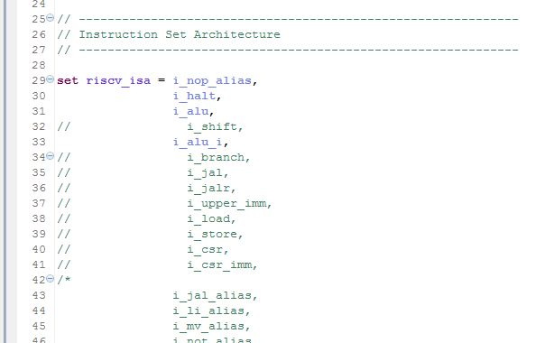
Class Project – isa.codal
The decoder is riscv_isa in isa.codal
Compares the input (the instruction) to all elements in riscv_isa
Calls the matching element
Uncomment the remaining elements, except for CSRs

Slide 9
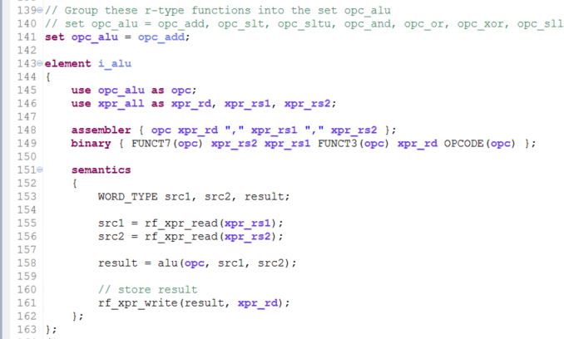
Class Project – isa.codal
isa.codal instruction element (group)
Which instructions are in it
Assembly definition
Machine code definition
Instruction execution

Slide 10
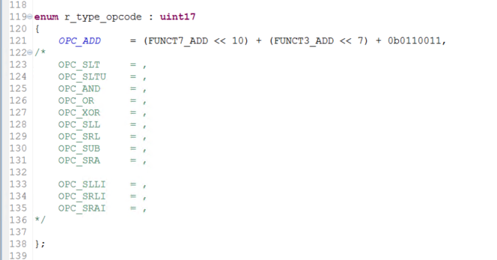
Class Project – opcodes.hcodal
opcodes.hcodal
Defines the opcode (17 bits)
Uncomment
Complete each instruction
Define internal constants
Assemble into instruciton

Slide 11
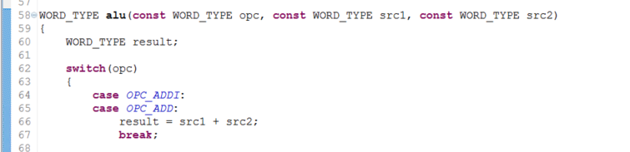
Class Project – ia_utils.codal
ia_utils.codal
Add function for each instruction
Functions from the comments below
Do not add or modify functions

Slide 12
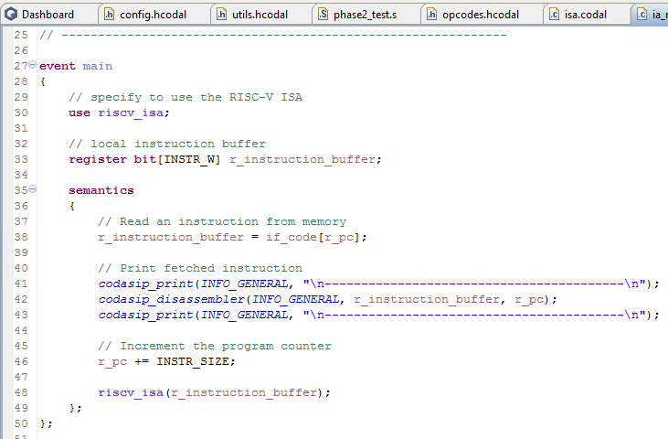
Class Project
ia_main_reset
Fetch an instruction
Increment the PC
Execute the decode (riscv_isa function in isa.codal)
Jump back
Repeat until stop

Slide 13
Class Project
If the simulation stops here (in ia_main_reset.codal):
You have fetched an illegal instruction
You have a bad instruction definition in opcodes.hcodal
You have an incorrect operation in isa.codal
Step to see which instruction causes this, and check that instruction carefully

Slide 14
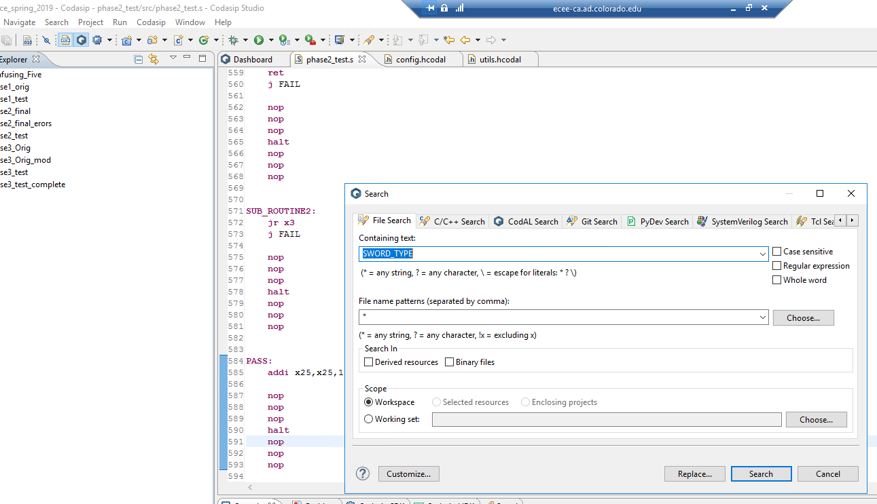
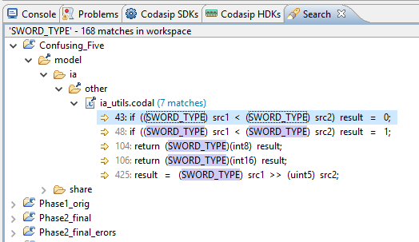
Codasip Search Function
Select Search function
Select “File”
Enter string to search
Shows all instances in Console

Slide 15
RISC-V: U-type Instructions
immediate[31:12]
rd
opcode
LUI – (IMM[31:12] :: 000000000000) → rd
AUIPC – (IMM[31:12] :: 000000000000) + PC → rd
Why add a constant to the PC in AUIPC?
Regularity!

Slide 16
RISC-V U-type Instruction Formats
OPCODE – selects individual instructions (no FN3)
NOTE: LUI/AUIPC adjacent
Upper immediate aligned with data path

Slide 17
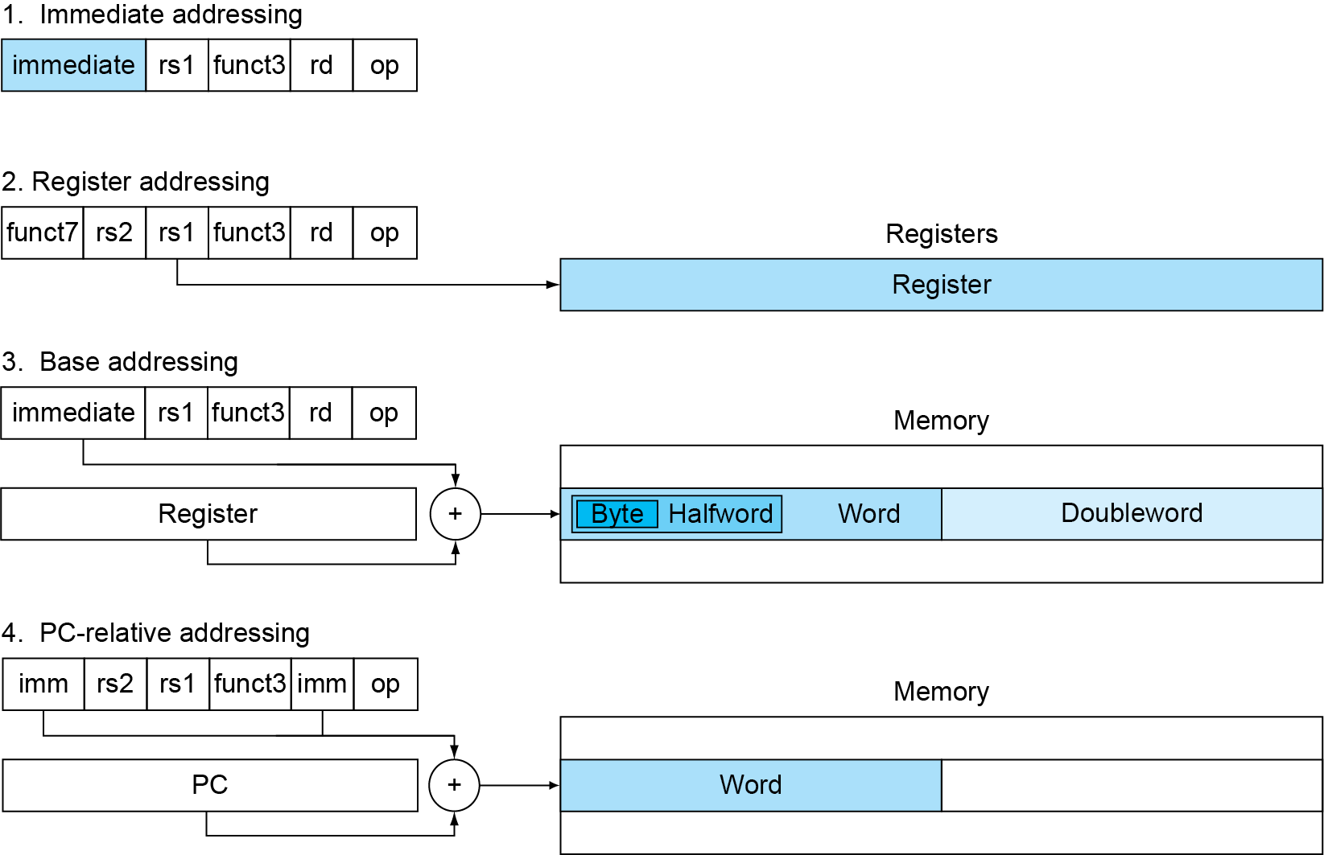
RISC-V: Addressing Summary

Slide 18
Definitions
Immediate addressing: where an operand is a constant within the instruction
Register addressing: where the operand(s) is a register
Base or displacement addressing: where the operand is at the memory location whose address is the sum of a register and a constant in the instruction
PC-relative addressing: where the branch address is the sum of the PC, Program Counter, and a constant in the instruction

Slide 19
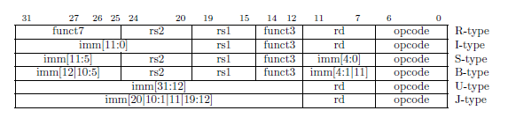
RISC-V Instruction Formats
OPCODE – selects format type in all cases
All fields are always aligned if they exist
Design Principle 1: Simplicity favors regularity
Regularity makes implementation simpler
Regularity makes pipelining possible
Simplicity enables higher performance at lower cost

Slide 20
RISC-V Small Immediates
Standard immediate is small (12 bits)
Why not larger (NIOS is 16 bits)?
Design Principle 2: Smaller is Faster
Small constants are common
Reduces available bits for other funcitons
Another good reason for only 32 registers (64 wouldn’t fit)

Slide 21
RISC-V Instruction Formats
Why not one consistent format?
Design Principle 3: Good design demands good compromises
Different formats complicate decoding, but allow 32-bit instructions uniformly
Keep formats as similar as possible

Slide 22
RISC-V Complex Immediates
Immediates are complex and seem difficult to handle
Simplifies the hardware by making instruction fields align
The sign is always the upper bit
Different immediates require only multiplexors which are fast
Only the Assembler author and the hardware designer care
Programmers see the Abstraction of Assembly Language

